Slide 1
The Economic Effect of the
2016 Elections on the
Real Estate Industry
Richard A. Hanson

Slide 2
U.S. Economic Overview
Percent Unemployed
Historical Unemployment Rate
U.S. Unemployment Peaked Oct ‘09 at 10%
4.9% in October ‘16
Source: BLS.gov`
2

Slide 3
Employment Drivers:
Education, Health Care & Professional Services Lead
Over-the-year employment change by major industry, October 2015-October 2016
(12-month percent change shown)
12-month net job change (thousands)
-0.5%
-12.8%
2.7%
2.6%
1.3%
1.9%
2.6%
2.1%
1.4%
2.5%
0.3%
Source: BLS.gov
3

Slide 4
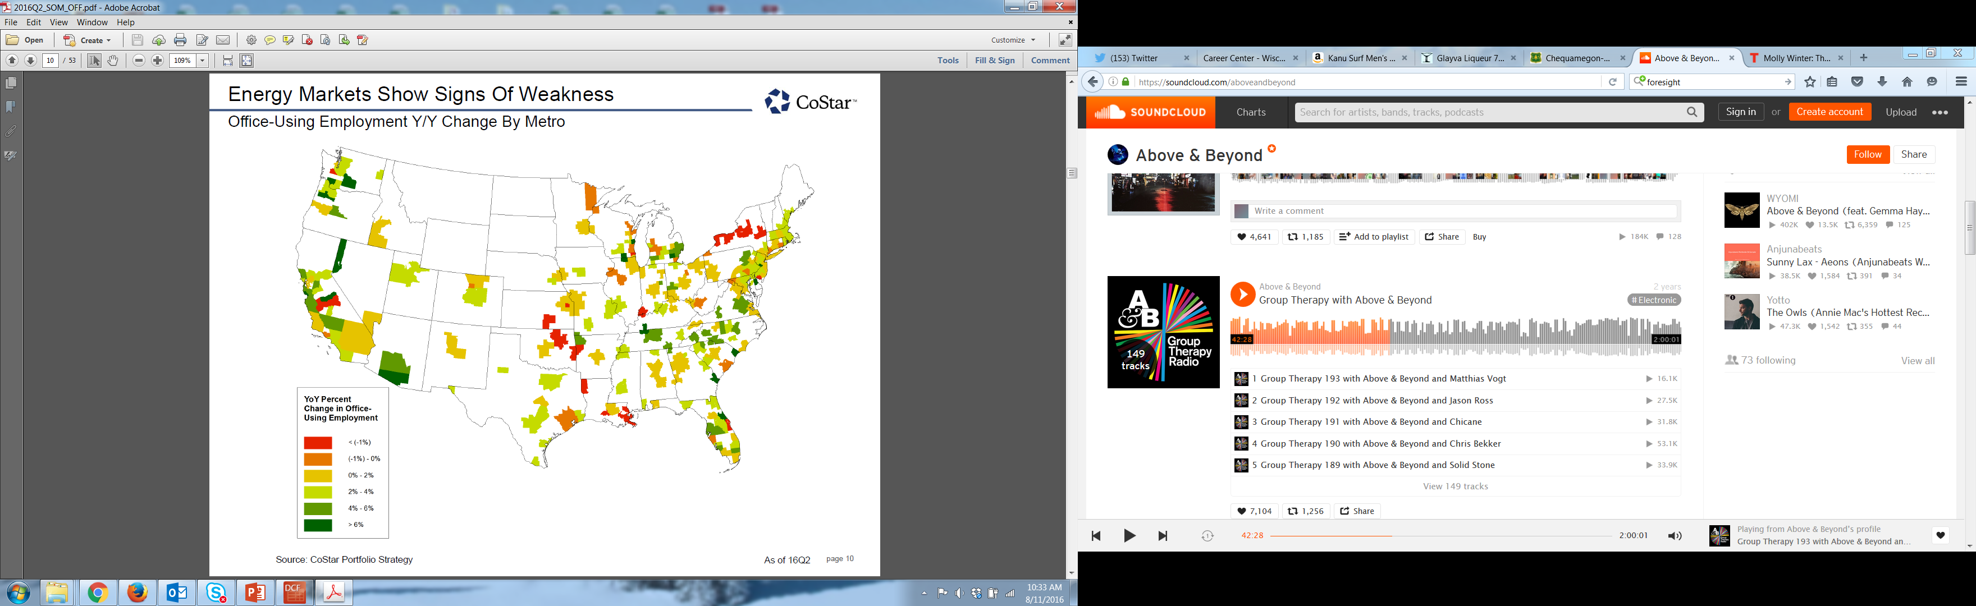
U.S. Office-Using Job Growth
Source:
Costar Portfolio Strategy, Moody’s Analytics
As of 2Q16
4

Slide 5
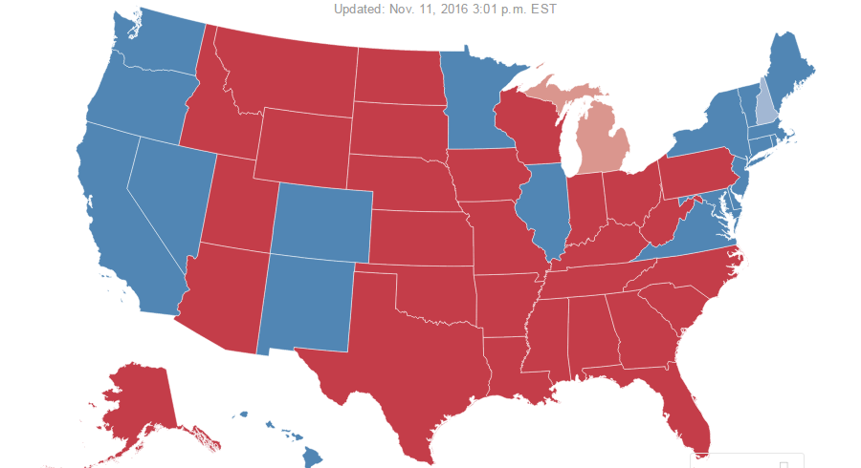
U.S. 2016 Election Results Map
Source:
NY Daily News
5

Slide 6
U.S. Office Market:
Construction Accelerates: Still Remains Under Historical Levels
3Q 2016
Market Size – 10.7 BSF
Net Absorption (YTD) – 88.4 MSF
Vacancy Rate 9.9%
Rents Increased 3.8% YoY
60 MSF Delivered YTD
147 MSF Under Construction
Source: Costar
6

Slide 7
U.S. Industrial Market:
Low Vacancy, Rising Rents Spur Construction
3Q 2016
Market Size – 21.8 BSF
Net Absorption (YTD) – 264 MSF
Vacancy Rate 5.6%
Rents Increased 6.4% YoY
199 MSF Delivered YTD
234 MSF Under Construction
Source: Costar
7

Slide 8
U.S. Retail Market:
Rent Growth Drives Construction
3Q 2016
Market Size – 13.0 BSF
Net Absorption (YTD) – 108 MSF
Vacancy Rate 5.0%
Rents Increased 2.8% YoY
58 MSF Delivered YTD
79 MSF Under Construction
Source: Costar
8

Slide 9
U.S. Investment Market:
Inbound Capital Flows
Foreign Investment in U.S. Totaled $94,766.9 Million in 2015
Canada accounted for $25,386.1 Million
Country | Total Props | Total Volume
China | 361 | $14,597.4
Canada | 370 | $12,150.3
Germany | 47 | $5,099.2
South Korea | 13 | $3,886.0
Hong Kong | 23 | $3,025.5
Qatar | 17 | $3,015.0
Singapore | 198 | $2,736.3
Switzerland | 179 | $2,508.2
Saudi Arabia | 5 | $1,824.5
Other | 270 | $11,152.7
Total | 1,483 | $59,995.3
Market | Total Props | Total Volume
Manhattan | 58 | $14,375.8
Los Angeles | 45 | $4,057.3
San Francisco | 22 | $3,293.0
DC | 29 | $2,863.6
Chicago | 39 | $2,447.5
Dallas | 27 | $2,190.0
Phoenix | 55 | $1,604.7
Boston | 26 | $1,593.6
San Diego | 16 | $1,505.7
Other | 1,166 | $26,064.0
Total | 1,483 | $59,995.3
Note: Compared to $47.1B in 2014; of which Canada invested $15.9 Billion
Note: Data for 2016 is YTD, the numbers above reflect amounts invested as of 10/10/2016
Source: Real Capital Analytics
9

Slide 10
U.S. Investment Market:
Buyer Types
$186.8
$17.8
Note: Transactional volume shown in millions.
Source: Real Capital Analytics
10

